Slide 1
2024년도 2학기
소프트웨어 공학
Homework #2
Structured Analysis for the RVC Control Software
202014612 전금신
202112323 김민재
202112346 정근녕
202112354 한승현

Slide 2
System Context Diagram
Motor
Front Sensor Input
Left Sensor Input
Right Sensor Input
Dust Sensor Input
Direction
RVC
Control
Sensor
Clean
Cleaner

Slide 3
Event List
Input / Output Event | Description
Front Sensor Input | Detects obstacles in front of the RVC
Left Sensor Input | Detects obstacles in the left side of the RVC periodically
Right Sensor Input | Detects obstacles in the right side of the RVC periodically
Dust Sensor Input | Detects dust on the floor periodically
Direction | Direction commands to the motor (go forward / go backward / turn left with an angle / turn right with an angle)
Cleaner | Turn off / Turn on / Power-Up

Slide 4
DFD Level 0
Front Sensor
Front Sensor Input
Motor
Direction
Left Sensor
RVC
Control
0
Left Sensor Input
Right Sensor Input
Right Sensor
Clean
Cleaner
Dust Sensor Input
Tick
Dust Sensor Input
Digital Clock

Slide 5
DFD Level 0 -
Process Specification
Reference No. | 0
Name | RVC Control
Input | Front Sensor Input, Left Sensor Input, Right Sensor Input, Dust Sensor Input, Tick
Output | Direction, Clean
Process Description | 정해진 주기대로 측정된 센서의 Input 값에 따라, Direction, Clean에 Output 데이터를 전송합니다.

Slide 6
DFD Level 0 -
Data Dictionary
Input / Output Event | Description | Format / Type
Front Sensor | Detects obstacles in front of the RVC | True/False, Interrupt
Left Sensor | Detects obstacles in the left side of the RVC periodically | True/False, Periodic
Right Sensor | Detects obstacles in the right side of the RVC periodically | True/False, Periodic
Dust Sensor | Detects dust on the floor periodically | True/False, Periodic
Direction | Direction commands to the motor (go forward / turn left with an angle / turn right with an angle / Turn backward) | Forward / Left / Right / Stop / Backward
Cleaner | Turn off / Turn on / Power-Up | On/Off/Up

Slide 7
Level 1
Front Sensor Input
Obstacle & Dust Detection
1
Direction
Cleaner & Motor Control
2
Left Sensor Input
Obstacle &
Dust Location &
Tick
Terminate
Right Sensor Input
Clean
Dust Sensor Input
TurnCount
Tick

Slide 8
DFD Level 1 -
Process Specification
Reference No. | 1
Name | Obstacle & Dust Detection
Input | Front Sensor Input, Left Sensor Input, Right Sensor Input, Dust Sensor Input, Tick
Output | Obstacle & Dust Location & Tick
Process Description | 정해진 주기마다 측정된 센서의 Input 값과 Tick을 Obstacle & Dust Location & Tick에 저장
Reference No. | 2
Name | Cleaner & Motor Control
Input | Obstacle & Dust Location & Tick, TurnCount
Output | Direction, Clean , Terminate
Process Description | TurnCount가 일정 수치 이상으로 올라가면 Terminate, Obstacle & DustLocation & Tick 에 저장되어있는 센서값, Tick을 계산하여 모터의 방향과 작동 여부를 결정하고, Cleaner의 터보 작동과 작동 여부를 결정.

Slide 9
DFD Level 1 -
Data Dictionary
Input / Output Event | Description | Format / Type
Front Sensor Input | Detects obstacles in front of the RVC | True/False, Interrupt
Left Sensor Input | Detects obstacles on the left side of the RVC periodically | True/False, Periodic
Right Sensor Input | Detects obstacles on the right side of the RVC periodically | True/False, Periodic
Dust Sensor Input | Detects dust on the floor periodically | True/False, Periodic
Direction | Determines whether motors work or not, and direction of motors (go forward / turn left with an angle / turn right with an angle / Turn backward) | Forward / Left / Right / Stop / Backward
Cleaner | Turn on / Turn off / Power-Up | On/Off/Up
TurnCount | Records the number of times the RVC Rotate in a row, to prevent an infinite Loop. If the RVC goes forward, initialized to zero | Integer

Slide 10
Level 2
Front Sensor Interface 1.1
Front Sensor Interface 1.1
Front Sensor Input
Front Obstacle
Determine Obstacle Location 1.5
Obstacle Location
Left Sensor Interface 1.2
Left Sensor Interface 1.2
Left Obstacle
Left Sensor Input
Tick
Right Obstacle
Right Sensor Interface 1.3
Right Sensor Interface 1.3
Determine Dust Existence 1.6
Dust Existence(2)
Right Sensor Input
Tick
Dust Sensor Interface 1.4
Dust Sensor Interface 1.4
Dust Sensor Input
Dust Existence(1)
Tick

Slide 11
Level 2
Direction
Motor Interface
2.2
Obstacle Location
Terminate
Motor Command
Main Control 2.1
Cleaner Interface 2.3
Clean
Cleaner Command
Dust Existence(2)
PowerUP
Tick
TurnCount

Slide 12
DFD Level 2 -
Process Specification
Reference No. | 1.1
Name | Front Sensor Interface
Input | Front Sensor Input, Tick
Output | Front Obstacle
Process Description | 항상 작동중인 Front Sensor의 Input 값을 Front Obstacle에 저장
Reference No. | 1.2
Name | Left Sensor Interface
Input | Left Sensor Input, Tick
Output | Left Obstacle
Process Description | 주기적으로 측정하는 Left Sensor의 Input 값을 Left Obstacle에 저장

Slide 13
DFD Level 2 -
Process Specification
Reference No. | 1.3
Name | Right Sensor Interface
Input | Right Sensor Input, Tick
Output | Right Obstacle
Process Description | 주기적으로 측정하는 Right Sensor의 Input 값을 Right Obstacle에 저장
Reference No. | 1.4
Name | Dust Sensor Interface
Input | Dust Sensor Input, Tick
Output | Dust Existence
Process Description | 주기적으로 측정하는 Dust Sensor의 Input 값을 Dust Obstacle에 저장

Slide 14
DFD Level 2 -
Process Specification
Reference No. | 1.5
Name | Determine Obstacle Location
Input | Front Obstacle, Left Obstacle, Right Obstacle
Output | Obstacle Location
Process Description | Front Obstacle, Left Obstacle, Right Obstacle 입력을 받아 Obstacle Location에 저장
Reference No. | 1.6
Name | Determine Dust Existence
Input | Dust Existence(1)
Output | Dust Existence(2)
Process Description | Dust Existence(1) 입력을 받아 Dust Existence(2)에 저장

Slide 15
DFD Level 2 -
Process Specification
Reference No. | 2.1
Name | Main Control
Input | Obstacle Location, Dust Existence(2), Tick, TurnCount
Output | Motor Command, Cleaner Command
Process Description | Obstacle Location, Dust Existence(2), Tick, TurnCount의 값을 읽어와 동작을 결정해, Motor Command, Cleaner Command를 전달
Reference No. | 2.2
Name | Motor Interface
Input | Motor Command
Output | Direction , Terminate
Process Description | Motor Command를 받아, Direction과 Teminate에 할당

Slide 16
DFD Level 2 -
Process Specification
Reference No. | 2.3
Name | Cleaner Interface
Input | Cleaner Command
Output | Clean , PowerUp
Process Description | Cleaner Command를 받아, Clean과 PowerUP에 할당

Slide 17
DFD Level 2 - Data Dictionary
Input / Output Event | Description | Format / Type
Front Sensor Input | Detects obstacles in front of the RVC | True/False, Interrupt
Left Sensor Input | Detects obstacles in the left side of the RVC periodically | True/False, Periodic
Right Sensor Input | Detects obstacles in the right side of the RVC periodically | True/False, Periodic
Dust Sensor Input | Detects dust on the floor periodically | True/False, Periodic
Front Obstacle | Obstacles in front of the RVC | True/False, Periodic
Left Obstacle | Obstacle on the left side of the RVC | True/False, Periodic
Right Obstacle | Obstacle on the right side of the RVC | True/False, Periodic
Dust Existence(1) | Dust detected in front of RVC by Dust Sensor | True/False, Periodic
Obstacle Location | Save Obstacle Location Data | Forward / Left / Right / Stop / Backward
Motor Command | Direction Commands | Forward / Left / Right / Stop / Backward
Dust Existence(2) | Save Dust Existence Data | True/False
Cleaner Command | Cleaner Turn off / Turn on | On / Off
Direction | Direction commands to the motor (go forward / turn left with an angle / turn right with an angle) | Forward / Left / Right / Stop / Backward
Terminate | RVC terminated when TurnCount rises above a certain level | trigger
Clean | Turn off / Turn on | On / Off
PowerUp | PowerUp for stronger cleaning | On / Off
TurnCount | Record the number of times the RVC Rotate to prevent an infinite Loop if the RVC goes forward, initialize to zero | integer

Slide 18
Level 3
Move Forward 2.1.2
Obstacle Location F/L/R
TurnCount
Enable
Terminate
2.1.3
Tick
Disable
Tick
Dust Existence
Trigger
Controller
2.1.1
Trigger
Turn Left
2.1.4
TurnCount
Tick
Trigger
Disable
TurnCount
Enable
Trigger
Turn Right
2.1.5
Tick
Tick
PowerUP
TurnCount
Clean
2.1.7
Turn
Backward
2.1.6
Tick

Slide 19
DFD Level 3 -
Process Specification
Reference No. | 2.1.1
Name | Controller
Input | Obstacle Location, Dust Existence, Tick, TurnCount
Output | Trigger, Enable, Disable, PowerUP, Tick
Process Description | Obstacle Location, Dust Existence, Tick, TurnCount를 받아 RCV의 동작을 결정. TurnCount는 최초 작동시 0으로 초기화되며, Controller가 입력을 받을 때마다 1씩 증가한다. Move Forward로부터 입력을 받을 경우 0으로 초기화된다.
Reference No. | 2.1.2
Name | Move Forward
Input | Enable , Disable
Output | TurnCount, Motor Command
Process Description | Controller에게 받은 입력을 통해, Motor Interface에 동작 전달 Command에게 “TurnCount를 0으로 초기화”를 전달

Slide 20
DFD Level 3 -
Process Specification
Reference No. | 2.1.3
Name | Terminate
Input | Trigger, Tick
Output | Motor Command
Process Description | TurnCount가 100 이상이면, RVC의 전원을 종료
Reference No. | 2.1.4
Name | Turn Left
Input | Trigger, Tick
Output | TurnCount, Motor Command
Process Description | Controller에게 받은 입력을 통해, Motor Interface에 동작을 전달 Command에게 “TurnCount에 1을 더함”을 전달

Slide 21
DFD Level 3 -
Process Specification
Reference No. | 2.1.5
Name | Turn Right
Input | Trigger, Tick
Output | TurnCount, Motor Command
Process Description | Controller에게 받은 입력을 통해, Motor Interface에 동작을 전달 Command에게 “TurnCount에 1을 더함”을 전달
Reference No. | 2.1.6
Name | Turn Backward
Input | Trigger, Tick
Output | TurnCount, Motor Command
Process Description | Controller에게 받은 입력을 통해, Motor Interface에 동작을 전달 Command에게 “TurnCount에 1을 더함”을 전달

Slide 22
DFD Level 3 -
Process Specification
Reference No. | 2.1.7
Name | Clean
Input | Disable , Enable , PowerUp , Tick
Output | Clean Command
Process Description | Controller에게 받은 입력을 통해, Clean Interface에 동작을 전달 PowerUp 시, Cleaner의 출력을 높인다.

Slide 23
DFD Level 3 - Data Dictionary
Input / Output Event | Description | Format / Type
Front Sensor Input | Detects obstacles in front of the RVC | True/False, Interrupt
Left Sensor Input | Detects obstacles in the left side of the RVC periodically | True/False, Periodic
Right Sensor Input | Detects obstacles in the right side of the RVC periodically | True/False, Periodic
Dust Sensor Input | Detects dust on the floor periodically | True/False, Periodic
Front Obstacle | Obstacles in front of the RVC | True/False, Periodic
Left Obstacle | Obstacle on the left side of the RVC | True/False, Periodic
Right Obstacle | Obstacle on the right side of the RVC | True/False, Periodic
Dust Existence(1) | Dust detected in front of RVC by Dust Sensor | True/False, Periodic
Obstacle Location F/L/R | Save Obstacle Location Data(Forward / Left / Right) | True/False
Motor Command | Direction Commands | Forward / Left / Right / Stop / Backward
Dust Existence(2) | Save Dust Existence Data | True/False
Cleaner Command | Cleaner Turn off / Turn on | On / Off
Direction | Direction commands to the motor (go forward / turn left with an angle / turn right with an angle) | Forward / Left / Right / Stop / Backward
Terminate | RVC terminated when TurnCount rises above a certain level | trigger
Clean | Turn off / Turn on | On / Off
PowerUp | PowerUp for stronger cleaning | On / Off
TurnCount | Record the number of times the RVC Rotate to prevent an infinite Loop if the RVC goes forward, initialize to zero | integer

Slide 24
Level 4
/ Enable “Move Forward”,
Cleaner Command (On)
Tick[!D] /
Cleaner Command (On)
Tick[D] / Cleaner Command (Up)
Move Forward
Tick [!F] && TurnCount < 100 /
Enable “Move Forward Cleaner Command (On),
turnCount = 0
Tick [F] /
Disable “Move Forward”,
Cleaner Command (Off),
Turn Left
Turn Right
Tick * 5 /
TurnCount ++
Tick * 5 /
TurnCount ++
Stop
Tick [F && !R && L] && TurnCount < 100 /
Trigger “Turn Right”
Tick [F && !L] && TurnCount < 100 /
Trigger “Turn Left”
Tick * 10 /
TurnCount ++
Tick [F && R && L] && TurnCount < 100 /
Trigger “Turn Backward”
TurnCount == 100 /
Terminate
Turn Backward

Slide 25
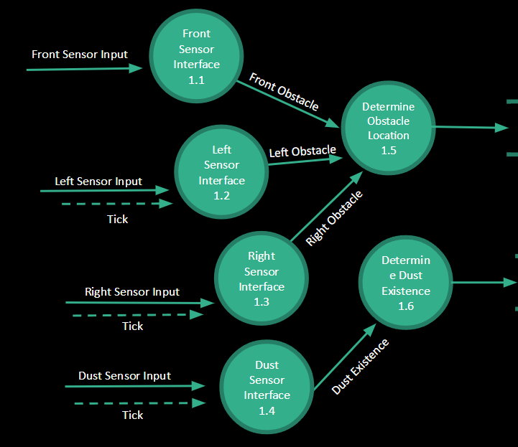
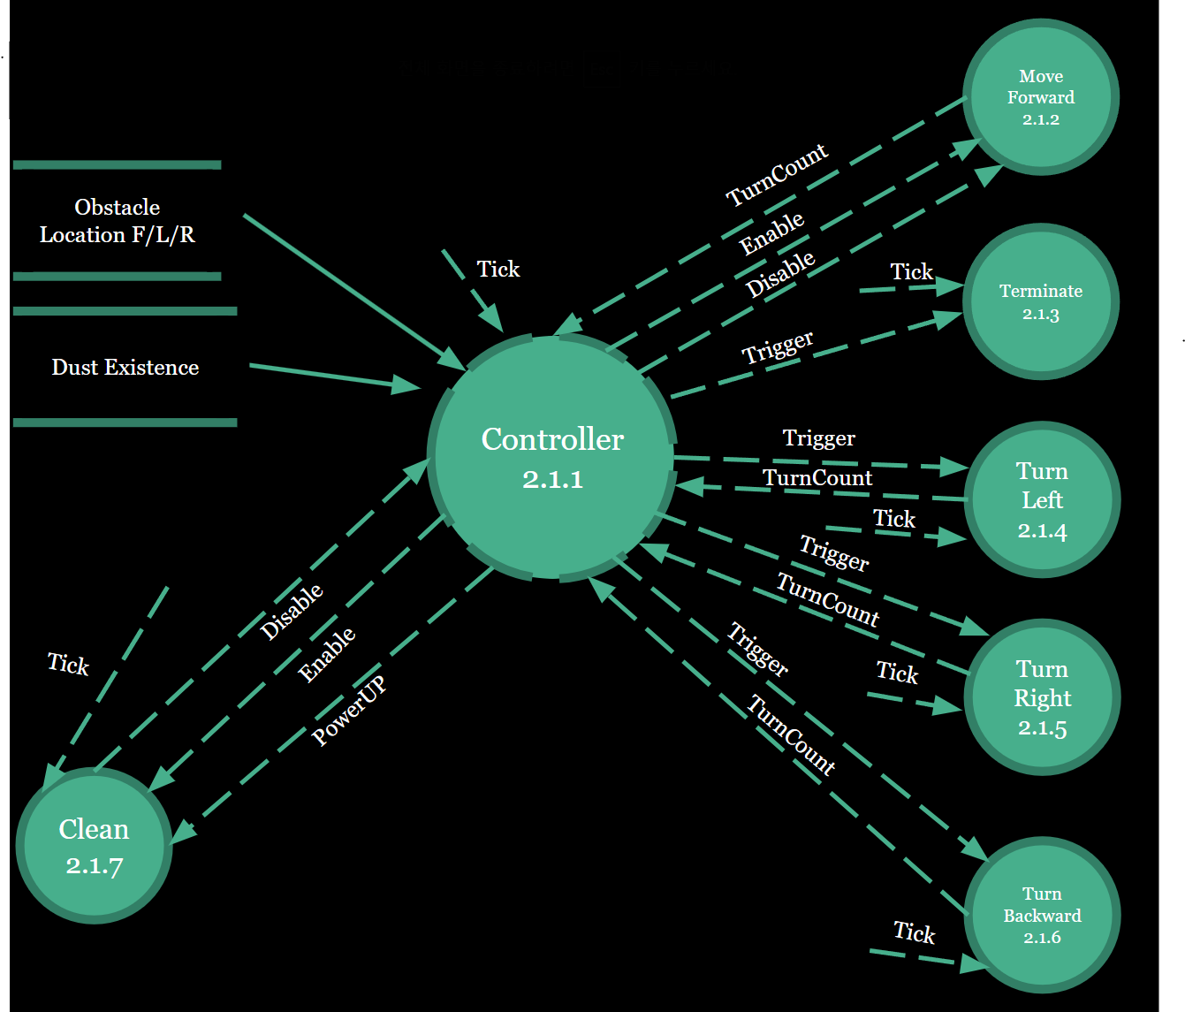
DFD - Overview

Slide 26
Data Flow
Control Flow
Main
Controller
Dust Existence
Obstacle Location
Determine Obstacle Location
Determine Dust Existence
Enable
Disable
Enable
Disable
PowerUp
Front Sensor
Interface
Left Sensor
Interface
Right Sensor
Interface
Dust Sensor
Interface
Trigger
Trigger
Trigger
Trigger
TurnCount
TurnCount
TurnCount
TurnCount
Move Forward
Terminate
Turn Left
Turn Right
Turn Backward
Clean

Slide 27
Specification Analysis
전방에 장애물이 없으면 Cleaner Mode를 On으로 전환하고 직진한다. 직진하는 동안 Dust Sensor가 먼지를 감지하면, Cleaner Mode를 Power up 모드로 전환하여 출력을 강화한다. 전방에 Dust가 더이상 감지되지 않으면 Power up 모드를 On으로 전환한다
전방에 장애물이 감지되어 기기가 직진을 할 수 없을 때에는 기기를 정지하고, Cleaner Mode를 Off로 전환하여 청소 동작을 일시적으로 정지시킨다. 기기의 왼쪽과 오른쪽에 장애물이 있는지 센서를 Periodic하게 작동시켜 탐지한다.
왼쪽에 장애물이 감지되지 않는다면 기기를 제자리에서 왼쪽으로 90도 회전하며, 오른쪽에 장애물이 감지되지 않는다면 기기를 제자리에서 오른쪽으로 90도 회전한다.
양쪽 모두에 장애물이 감지되지 않는다면 왼쪽으로 회전한다.
왼쪽과 오른쪽 모두 장애물이 감지되면, 기기를 제자리에서 왼쪽으로 180도 회전한다.
직진 동작 없이 회전 동작이 100회 이상 연속으로 발생할 경우, 기기가 정상 작동하지 못하는 상황으로 판단하여 기기의 전원을 종료한다.

